Slide 1
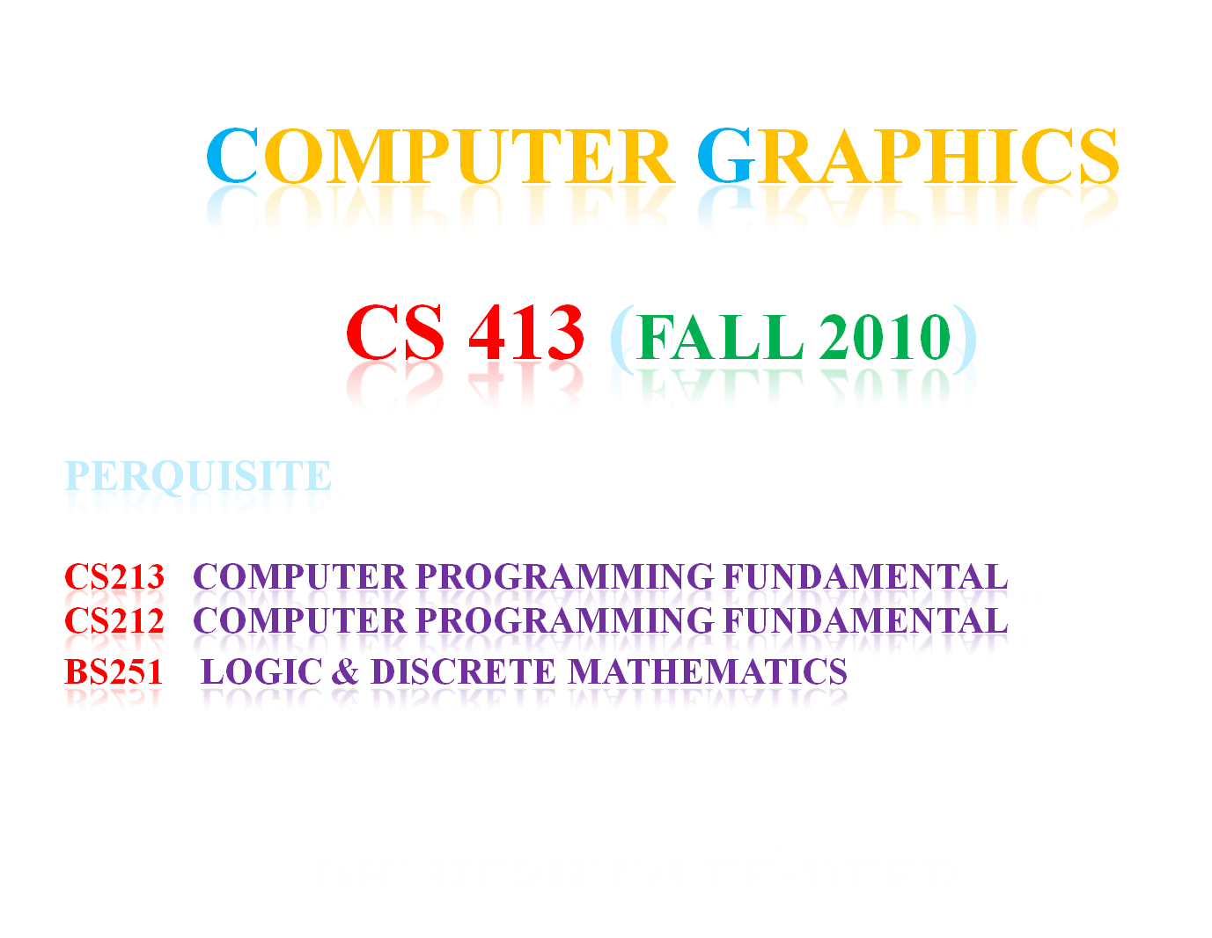

Slide 2
References & User group
Reference:
Computer Graphics with OpenGL
Hearn Baker
Third Edition (2004)
User group:
Computergraphics_cs413@yahoogroups.com

Slide 3
Course Syllabus ( CS 413)
Lecture 1 : Computer Graphics Basic Concepts
Lecture 2 : Output Primitives
Lecture 3 : 2D Geometric Transformation
Lecture 4 : 2D Viewing
Lecture 5 : Aliasing
Lecture 6 : Transform Matrices
Lecture 7 : Collision Detection
Lecture 8 : Graphics Hardware
Lecture 9 : Triangle Strips & Meshes and Pipeline Optimization

Slide 4
Course CS 413 Evaluation Policy
20 % attendance , quizzes , assignments and section activities
20 % Midterm Exam
60 % Final Exam

Slide 5

Lecture 1

Slide 6
Lecture 1
1.1 Introduction
1.1.1 Computer Graphics Definition
1.1.2 Computer Graphics Applications
1.1.3 Modes of operations
1.1.4 Characteristics of Computer Graphics
1.2 Computer Graphics Components
1.2.1 Computer Graphics H/W & S/W
1.2.2 Computer Graphics input devices
1.2.3 Computer Graphics output devices
1.3 Display Technologies
1.4 Up _ to _date Technologies

Slide 7
1.1.1 Computer Graphics Definition
“Computer Graphics” is defined as methods and techniques for converting data to and from graphical display via computer system” ( Definition 1)
Computer Graphics studies the means to model, represent, manipulate, and display geometric objects with computers
The “Computer System” provides a set of tools to create pictures and to interact them into a natural way
The tools consist of both hardware and software with strong graphics capabilities

Slide 8
Computer Graphics Definition-contn
representation and manipulation of pictorial data by a computer( Definition 2).
a sub-field of computer science which studies methods for digitally synthesizing and manipulating visual content ( Definition 3).
the various technologies used to create and manipulate such pictorial data ( Definition 4).
In 1960 William Fetter, a graphic designer for Boeing Aircraft Co., was credited with coining the phrase "Computer Graphics" to describe what he was doing at Boeing at the time

Slide 9
CG history
During the late 1970s, personal computers became more powerful, capable of drawing both basic and complex shapes and designs.
In the 1980s, artists and graphic designers began to see the personal computer, particularly the Commodore Amiga and Macintosh, as a serious design tool, one that could save time and draw more accurately than other methods.

Slide 10
CG history-contn
3D computer graphics became possible in the late 1980s with the powerful SGI computers, which were later used to create some of the first fully computer-generated short films at Pixar.
The Macintosh remains one of the most popular tools for computer graphics in graphic design studios and businesses.

Slide 11

Pixar: Monster’s Inc.

Slide 12
CG history-contn
Modern computer systems, dating from the 1980s and onwards, often use a graphical user interface (GUI) to present data and information with symbols, icons and pictures, rather than text.
Graphics are one of the five key elements of multimedia technology.

Slide 13
CG history-contn
3D graphics became more popular in the 1990s in gaming, multimedia and animation.
In 1995, Toy Story, the first full-length computer-generated animation film, was released in cinemas worldwide.
In 1996, Quake, one of the first fully 3D games, was released.
Since then, computer graphics have become more accurate and detailed, due to more advanced computers and better 3D modeling software applications, such as Cinema 4D.

Slide 14
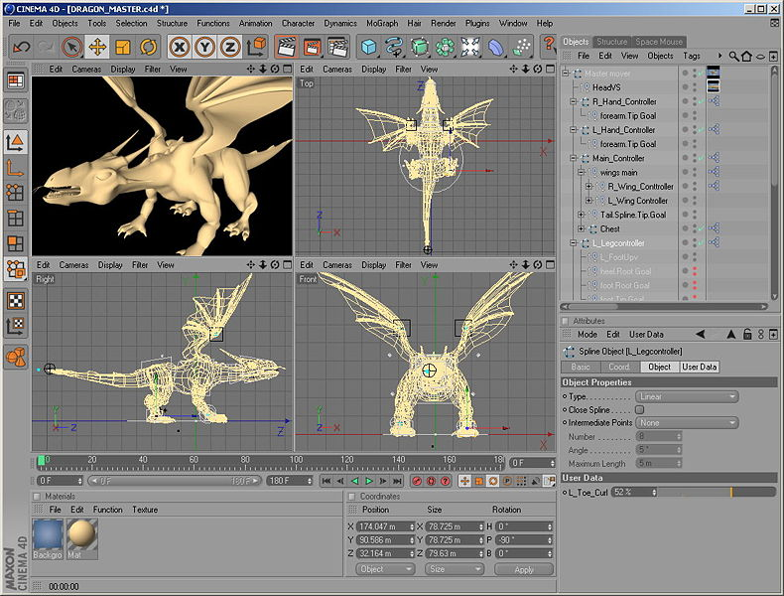
CINEMA 4D is a commercial cross platform high-end 3D graphics application produced by MAXON Computer GmbH of Friedrichsdorf, Germany. It is capable of procedural and polygonal/subd modeling, animating, lighting, texturing and rendering, and is noted for being very easy to use and artist friendly among high end 3D applications and having a very flexible interface.

Slide 15
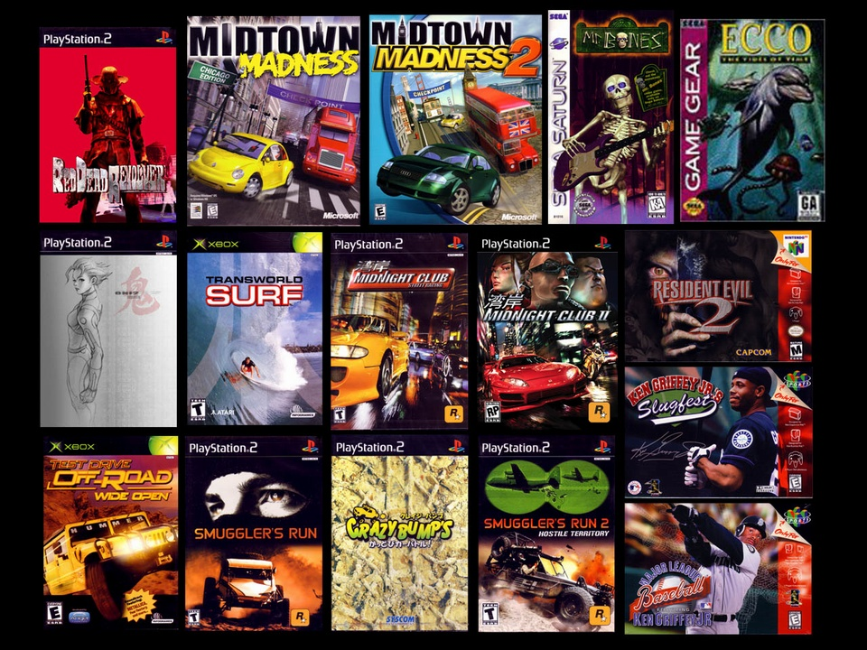
Angel Games

Slide 16
Historical Milestones
1960’s:
  Early theoretical development, mainly limited to research and military
  1962: Sketchpad (Ivan Sutherland)
1970’s:
  ‘Traditional’ graphics pipeline developed
  Driven by money from military simulation and automotive design industries
1980’s:
  Many important core algorithms developed
  Visual quality improved driven by demands from movie industry
  1985: Rendering Equation (James Kajiya)
1990’s:
  Advanced algorithms developed as graphics theory matured
  Broader focus on animation, data acquisition, physics
2000’s:
  Photoreal rendering evolves to the point of being able to render convincing images of arbitrarily complex scenes on consumer hardware
  Merging of computer graphics and computer vision
  Cheap graphics hardware with vast capabilities, driven largely by video game industry

Slide 17
1.1.2 Computer Graphics Applications
Computational biology
Computational physics
Computer-aided design
Computer simulation
Digital art
Education
Entertainment
Graphic design
Info-graphics
Information visualization
Scientific visualization
Virtual reality
Web design
GIS (Geographic Information Systems)

Slide 18

*******************************

Slide 19
Computer Graphics Tools
3Ds MAX ( Autodesk)
AC3D (Inivis)
Aladdin 4D (Discreet FX)
Blender (Blender Foundation)
Carrarra ( DAZ Productions)
Cinema 4D ( MAXON)
CityEngine ( Procedural Inc)
Cobalt ( CAD)
LightWave 3D ( New Tek)
Maya ( Autodesk )
Modo ( Luxology )

Slide 20
1.1.3 Modes of Operation
Passive Graphics
Data is mapped onto the display surface of the graphic devices
Interactive Graphics
Data is mapped into the display surface of the graphic device
The user can interact with the image by a way of input graphic device (e.g. mouse) ;which allow to ease the dialog between the user and applications programs

Slide 21
1.1.4 Characteristics of Computer Graphics Systems
The current generation of computer graphics system are device independent
Most systems include device converting both interactive hardcopy devices (e.g. plotters, printers) and softcopy devices (e.g. screens)
Portability of application programs can be a major problem ( costly & tedious )
Systems provide graphical tools and functions for creating and manipulating a graphics primitives, device controller, input and output

Slide 22
Assignment 1
Compare between the following computer graphics applications ( purpose, techniques, technologies)
1- Computer Aid Design (CAD)
2- Computer Aid Manufacture (CAM)
3- Computer Aid Engineering (CAE)
4- Art and Animation
5- Medical
6- Simulators
7- Virtual Reality
8- GIS

Slide 23
Computer Graphics vs. Image Processing
Computer Graphics
(synthesis/generation)
Image Model
Image
(construction of images from scratch)
Image Processing
(analysis)
Image
Enhanced Processed Image
(operations such as color correction, scaling, blurring, sharpening)

Slide 24
Image Synthesis
Image synthesis or image generation refers more to the construction of images from scratch, rather than processing of existing images
Synthesis of a 2D image from a 3D scene description is more commonly called rendering ( translation from reality to screen domain )

Slide 25
2D Computer Graphics
Pixel art is a form of digital art, created through the use of raster graphics software, where images are edited on the pixel level
Vector graphics are complementary to raster graphics, which is the representation of images as an array of pixels, as it is typically used for the representation of photographic images.

Slide 26
Raster & Vector Graphics
Modern graphics displays are raster based
This just means that they display a grid of pixels, where each pixel color can be set independently
Raster graphics are also sometimes called bitmapped graphics
Individual pixels are usually formed from smaller red, green, and blue sub-pixels
Older style vector displays didn’t display a grid of pixels, but instead drew lines directly with an electron beam (CRT Technology )

Slide 27
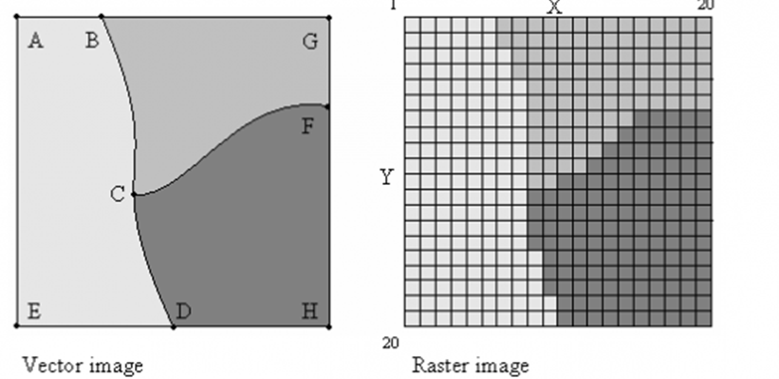
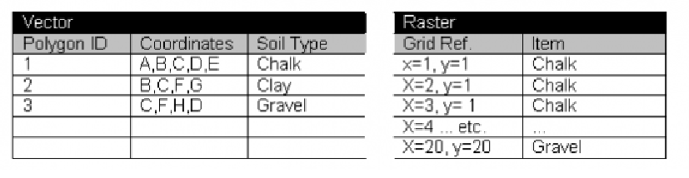
Vector and Raster 2D Graphics

Slide 28
3D Computer Graphics
are graphics that use a three-dimensional representation of geometric data that is stored in the computer, for the purposes of performing calculations and rendering 2D images. Such images may be for later display or for real-time viewing.
Computer animation is the art of creating moving images ( 3 D ) via the use of computers

Slide 29
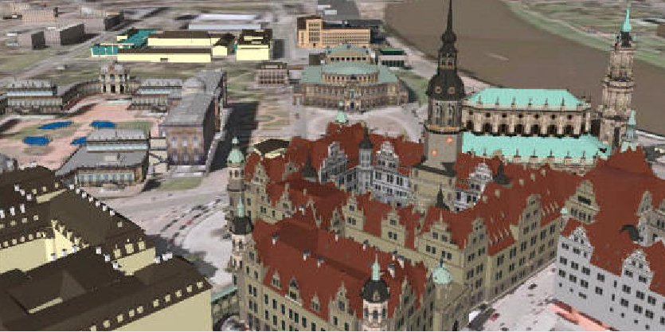
3D Graphics

Slide 30
3D Models
A basic 3D model might consist of a simple array of triangles
Each triangle stores 3 vertices
Each vertex contains an xyz position, and possibly some other information (color, …)

Slide 31
3D Models
class Vector3 {
  float x,y,z;
};
class Vertex {
  Vector3 Position;
};
class Triangle {
  Vertex Vert[3];
};
class Model {
  int NumTris;
  Triangle *Tri;
};

Slide 32
Traditional Graphics Pipeline
In the traditional graphics pipeline, each primitive is processed through the following steps:
  Transformation
  Lighting
  Clipping
  Scan conversion
  Pixel processing

Slide 33
Transformation
The transformation process refers to the linear transformation from 3D space to a 2D viewing space
Ultimately, each vertex position must be transformed from it’s defining object space to the device coordinates (pixel space)
This often involves a combination of rotations, translations, scales, and perspective transformations

Slide 34
Lighting
Lighting operations are applied to each vertex to compute its color
In more advanced rendering, lighting operations are computed per pixel, rather than per vertex
A variety of light types can be defined such as:
point lights,
directional lights,
spot lights
More advanced lighting operations can account for:
shadows,
reflections,
transparency,
a wide variety of optical effects

Slide 35
Clipping
Some triangles will be completely visible on the screen, while others may be completely out of view
Some may intersect the side of the screen and require special handling
The camera’s viewable space forms a volume called the view volume. Triangles that intersect the boundary of the view volume must be clipped.
The related process of culling refers to the determination of which primitives are completely invisible
The output of the clipping/culling process is a set of visible triangles that lie within the dimensions of the display device

Slide 36
Rasteraization (Scan Conversion)
The scan conversion (or rasterization) process takes 2D triangles as input and outputs the exact pixels covered by the triangle
Triangle Pixels
Rasterization (Scan Conversion )
2D Triangles
Additional Pixel Data ( e.g. interpolated depth (z), color)

Slide 37
Pixel Processing
The output of the scan conversion process is a bunch of individual xy pixels, plus additional data per pixel such as interpolated depth (z), color, or other information
The pixel processing stage includes the operations that take place per pixel to compute the final color that gets rendered into the framebuffer
Usually, the zbuffer technique is used to make sure that a pixel is rendered only if it is not blocked by an existing surface
Other processing, such as texturing and transparency operations happen per pixel
In some systems, the entire lighting process is computed per pixel, instead of per vertex

Slide 38
Scene Rendering
With the traditional zbuffered graphics pipeline, triangles can be rendered in any order without affecting the final image
Often, complex effects such as transparency, actually do depend on the rendering order
Still, it makes a nice basic approach, and it’s the approach taken by OpenGL and built into many modern hardware graphics boards
There are more advanced rendering algorithms (scan line, ray tracing, etc.) that don’t render triangles one at a time, and require the entire scene to be processed.

Slide 39
1.2 Computer Graphics Components
1.2.1 Computer Graphics H/W & S/W
Graphics Hardware
Graphics input devices ( e.g. keyboard and mouse )
Graphics output devices ( e.g. monitor)
Internal graphics processing units.
Graphics Software
consists of three parts:
1- Application model: geometric models and data used for an application.
2- Application program: programs developed to handle a special task or application.
3- Graphics system: a library of graphics functions, supported by operating systems. These graphics functions are invoked by high level application programs to control low level graphics hardware( e.g. OpenGL)

Slide 40
OpenGL (Open Graphics Library)
is a standard specification defining a cross-language cross-platform API for writing applications that produce 2D and 3D computer graphics.
The interface consists of over 250 different function calls which can be used to draw complex three-dimensional scenes from simple primitives.
OpenGL was developed by Silicon Graphics Inc. (SGI) in 1992 and is widely used in CAD, virtual reality, scientific visualization, information visualization, and flight simulation.

Slide 41
OpenGL (Open Graphics Library)-contn
It is also used in video games, where it competes with Direct3D on Microsoft Windows platforms
It’s advantage:
freeing the programmer from the job of re-inventing the wheel (i.e. implementing low level graphics functions)
freeing the Central Processor Unit (CPU) from performing a lot of the processing since this can be implemented in hardware on a chip on the graphics display hardware

Slide 42
OpenGL Example
Here’s an example that renders a colored triangle (Note that this doesn’t include any ‘setup’ code)
  glBegin(GL_TRIANGLES);
  glColor3f(1.0, 0.0, 0.0); // red
  glVertex3f(-4.0, -2.0, 0.0);
  glColor3f(0.0, 1.0, 0.0); // green
  glVertex3f(4.0, -2.0, 0.0);
  glColor3f(0.0, 0.0, 1.0); // blue
  glVertex3f(0.0, 5.0, 0.0);
  glEnd();

Slide 43
OpenGL Program Organization
Here’s a rough example of how a typical GL program might be organized:
main() {
// Initialization code:
// - Open window
// - Load & define texture maps, etc.
while(not finished) {
// Frame set up code:
// - Clear screen
// - Specify camera position & properties
// - Specify lighting information
for(each object) {
// Object set up code
// - Specify object position & orientation (matrix)
for(each material) {
// Specify material properties
// - Lighting properties
// - Texture properties
for(each primitive) {
// Render primitive (glBegin, glVertex3f…)
}
}
}
// Frame completion code (glSwapbuffers()…)
}
// Shutdown code
}

Slide 44
1.2.2 Graphics Input Device
The graphics input devices (Analog devices & Digital devices) are devices that allow the information from outside the computer to be communicated with the computer
Analog Input Devices examples:
Track ball
Joystick
Mouse
Image Scanner
The analog input devices need analog to digital converter (A/D) to change the analog signals to a digital form understandable by the processors.

Slide 45
How do Joystick, Mouse, Trackball work?
The mouse is an integral part of the graphical user interface (GUI) of any personal computer
The mouse is one of the input analog graphic devices that uses the setting of variable resistors to compute the location of the ball of the mouse
As the ball is moved over the surface in any direction, a sensor sends impulses to the computer that causes a mouse-responsive program to reposition a visible indicator (called a cursor) on the display screen.
The positioning is relative to some variable starting place. Viewing the cursor's present position, the user readjusts the position by moving the mouse.
The joystick and trackball work with variable resistors as the mouse.

Slide 46

Trackball
Essentially, a trackball is a mouse lying on its back
To move the pointer, you rotate the ball with your thumb, your fingers, or the palm of your hand
There are usually one to three buttons next to the ball, which you use just like mouse buttons
The advantage of trackballs over mice is that the trackball is stationary so it does not require much space to use it

Slide 47
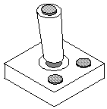
Joy stick
A lever that moves in all directions and controls the movement of a pointer or some other display symbol
With a joystick, the pointer continues moving in the direction the joystick is pointing
To stop the pointer, you must return the joystick to its upright position
Spring loaded joysticks return to the upright position when released

Slide 48
Digital Input Devices Examples
Keyboard
Digitized camera
Data glove:
a glove with sensors (18 - 22) embedded at finger joints to measure the bending of the fingers. Used to control a virtual hand for grasping, dropping, and moving an object in a virtual environment
Touch panel:
highly transparent and embedded over a display surface
Light pen:
when the beam is light touched the output screen and integral button pressed, the processor is able to detect the fact and ascertain location of the position pointed to by the light beam

Slide 49
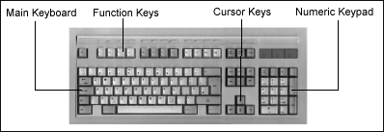
keyboard
Text input device that used mechanical contact closure, change in capacitance, and magnetic coupling
Creates a unique code corresponding to the key pressed (ASCII or EBCDIC)
Chording allows users to press several keys at once for rapid access to different commands

Slide 50
Touch Panel
Allows user to touch the screen surface directly to move the cursor
Infrared LEDs and light sensors for a grid of invisible light beams over the display area. Touching the screen breaks one or two vertical and horizontal light beams, indicating the fingers position on the display surface.
Finger is a large object difficult to point to or select small areas on the display

Slide 51
1.2.3 Graphics Output Device
These devices have a capability of producing a graphical outputs
Examples:
Raster Scan Cathode Ray Tube ( CRT )
Plasma Display
(like the one used in portable case computers)
Liquid Crystal Display (LCD)
(like one used in games, watches)
Plotters and Printers

Slide 52
The Graphical Output
Output devices can be categorized as:
Hardcopy devices: are these devices that produce permanent pictures that can be documented.
Example : plotters, printers, ink-jitters
Softcopy devices: are these devices produce volatile(evaporated) copy of the image.
Example : Monitors (Screens)

Slide 53
*******************************

Slide 54
1.3 Display Technology
Vector display (cathode ray tube)
Raster displays
  CRT (cathode ray tube)
  LCD (liquid crystal display)
  TFT (thin film transistor)
  OLED (organic light emitting diode)
  Light valve
  Plasma
  HDR (high dynamic range)
Film
Print

Slide 55
Resolution & Frame Rates
Video:
  NTSC: 720 x 480 @ 30 Hz (interlaced)
  PAL: 720 x 576 @ 25 Hz (interlaced)
HDTV:
  720p: 1280 x 720 @ 60 Hz
  1080i: 1920 x 1080 @ 30 Hz (interlaced)
  1080p: 1920 x 1080 @ 60 Hz
Film:
  35mm: ~2000 x ~1500 @ 24 Hz
  70mm: ~4000 x ~2000 @ 24 Hz
  IMAX: ~5000 x ~4000 @ 24-48 Hz
Refresh rate is the speed of displaying the framebuffer on the screen in frame/sec
Hz (Hertz) = frames per second (fps)
Video standards with an i (such as 1080i) are interlaced scan, while standards with a p (1080p) are progressive scan

Slide 56
Interlacing
Older video formats (NTSC, PAL) and some HD formats (1080i) use a technique called interlacing
With this technique, the image is actually displayed twice, once showing the odd scanlines, and once showing the even scanlines (faster without flicker )
This is a trick for achieving higher vertical resolution at the expense of frame rate (cuts effective frame rate in half) i.e. Interlaced refresh rate is half that of the non-interlaced mode
NTSC video, for example, is 720 x 480 at 30 frames per second, but is really 720 x 240 at 60 frames per second

Slide 57
Interlacing-contn
Interlacing is an important issue to consider when working with video, especially in animation as in TV effects and video games
Computer monitors are generally not interlaced ( slower with flicker )
no of bits/sec needed to transfer the contents out from the framebuffer = ( Refresh rate) * ( framebuffer size)

Slide 58
Framebuffer
The framebuffer is a video output device that drives a video display from a memory buffer containing a complete frame of data. The information in the buffer typically consists of color values for every pixel (point that can be displayed) on the screen.
Color values are commonly stored in 1-bit monochrome, 4-bit palletized, 8-bit palletized, 16-bit highcolor and 24-bit truecolor formats.
An additional alpha channel is sometimes used to retain information about pixel transparency.
The total amount of the memory required to drive the framebuffer is dependent on:
the resolution of the output signal, as well as
the color depth and
palette size.

Slide 59
Framebuffer-contn
The framebuffer refers to the memory dedicated to storing the image
It would generally be a 2D array of pixels, where each pixel stores a color
Color is typically stored as a 24 bit RGB value. This offers 8 bits (256 levels) for red, green, and blue, for a total of 16,777,216 different colors
Very often, additional data is stored per pixel such as depth (z)
Size of framebuffer = height * width * no of bits per pixel
= H * W * b

Slide 60
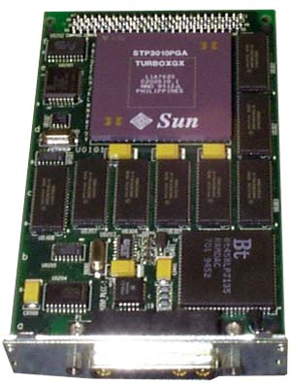
Framebuffer Example
Sun TGX Framebuffer

Slide 61
b = Bits per Pixel = no of bit planes
Max no of Colors per pixel = 2^{b}
1 bpp, 2¹ = 2 colors (monochrome)
2 bpp, 2² = 4 colors
3 bpp, 2³ = 8 colors
...
8 bpp, 2⁸ = 256 colors
16 bpp, 2¹⁶ = 65,536 colors ("Highcolor" )
24 bpp, 2²⁴ ≈ 16.7 million colors ("Truecolor")

Slide 62
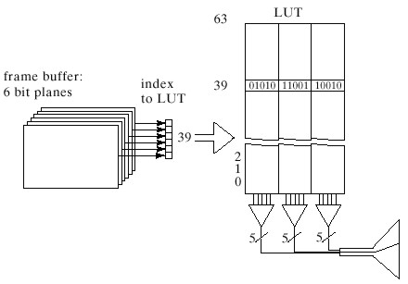
Framebuffer Disadvantages
It occupies a large memory space
It doesn’t provide a large number of colors → image resolution decreases
The solution will be via Locked up table (LUT)
A color display system that incorporates an LUT

Slide 63
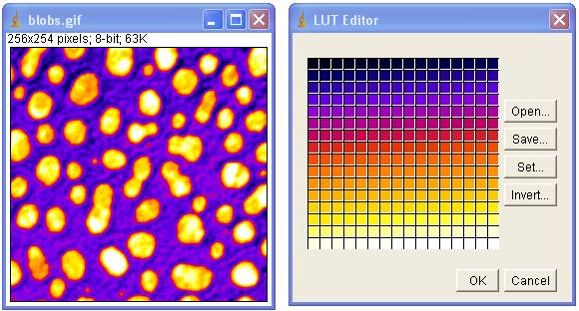
Look-Up Table (LUT)
LUT is the abbreviation for look-up-table. Simply, a LUT is a table of equivalents that convert brightness and darkness in an image into numbers.
Thus in an 8-bit gray scale system, black is set to zero, and white is 255, and all of the other gradations of intensity are given values between them [ 1: 254 ].

Slide 64
Look-Up Table (LUT)-contn
LUT offers a programmable association between a pixel values and the final displayed color
if a raster display has a color depth of b bits (so that there are b bit planes in its frame buffer) and each LUT entry is n bit wide.
Using FrameBuffer alone, the system can display 2^{b} colors maximum
While adding the LUT, the system can display 2^{n} colors maximum (i.e. more existing colors → higher resolution)
no. of memory bytes required by the LUT = (n*2^{b})/8

Slide 65
Assignment 2
1. A system with maximum 128 colors, Pixel Aspect Ratio (PAR)= 0.8 and frame buffer size of 320 Kbytes,
find height , width and the maximum image size that could be displayed with the maximum color on such a system , given that the aspect ratio = height/width
2. A system with 8 bit planes and LUT width of 16 bits, the width of the display screen ( w) = 600, and of height ( h) = 800, Calculate
(a) the maximum number of colors displayed by this frame buffer
(b) the total maximum number of colors using the LUT
(c) the number of memory bytes required by the LUT
3. For a monitor 1024*768 with 8 bits per pixel, refresh rate = 60 frame/sec, find:
(a) Size of the frame buffer
(b) Number of bits/sec transferred out of the frame buffer for non-interlaced mode
(c) Number of bits/sec transferred out of the frame buffer for interlaced mode

Slide 66
Primitives
Complex scenes are usually built up from simpler objects
Objects are built from individual primitives
The most common and general purpose 3D primitive is the triangle
Points and lines are also useful primitives
More complex shapes such as n-sided polygons, spheres, curves, curved surfaces, and fractals can be considered as primitives as well, but often, these are just automatically tessellated into triangles in a pre-rendering phase, and so aren’t true primitives

Slide 67
Modern Display Technologies
Video Display (B/W & Colored)
(Raster Scan / Random Scan CRT display)
Liquid Crystal Display (LCD’s)
Plasma Display
Field Emission Display (FED’s)
Light Emitting Diode (LED’s)
Digital Micromirror Devices (DMD)
Liquid Crystal on Silicon (LCOS Technology)
Gratings Light Valves (GLV Technology)

Slide 68
1.3.1 Cathode Ray Tubes (CRTs)
  A beam of electrons emitted by electron gun passes through focusing and deflection systems that direct the beam toward specified positions on the phosphor coated screen.
  To maintain the screen picture, we need to redraw the picture repeatedly; this is called refresh CRT.

Slide 69
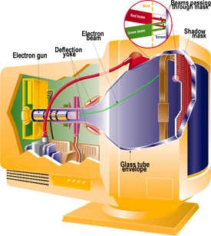
Display Technologies
Cathode Ray Tubes (CRTs)
  Most common display
  device today
  Evacuated glass bottle
  (last remaining vacuum tube)
  Heating element (filament)
  Electrons attracted to
  focusing anode cylinder
  Vertical and Horizontal
  deflection plates
  Beam strikes phosphor
  coating on front screen

Slide 70
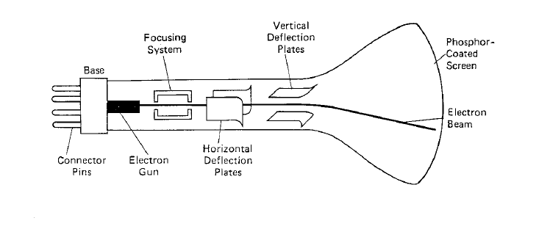
Cathode Ray Tubes (CRTs)
Focusing
Electrostatic
Magnetic
Deflection
Electrostatic
Magnetic

Slide 71
Color CRT monitors
There are two basic techniques:-
  Beam-penetration:-
    Two layers of phosphor (red ,green) are coated inside CRT screen.
    The displayed color depends on how far the electron beam penetrate phosphor layers.
  Shadow-mask :-
    CRT has 3 phosphor color dots at each pixel position and it has 3 guns R,G,B.
    The shadow mask contains a set of holes aligned with the phosphor pattern, when the beams pass through a hole in the shadow mask, it activate a dot triangle as in figure.

Slide 72
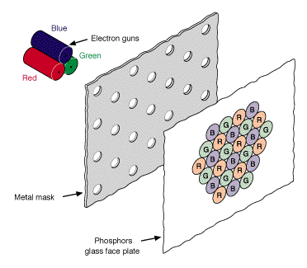
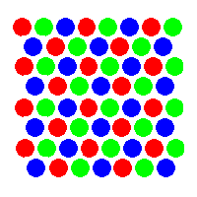
Shadow-mask

Slide 73
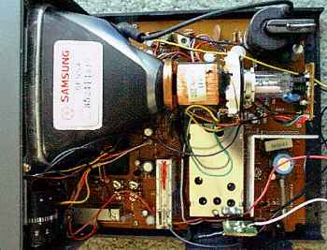
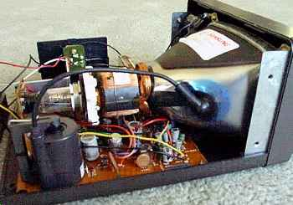
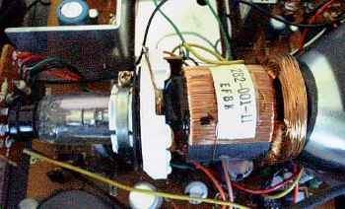
Cathode Ray Tubes (CRTs)

Slide 74
Cathode Ray Tubes (CRTs)-Contn
Components of CRTs:-
  Heating element (filament) as an electron gun
  Control grid that control the beam of electrons by setting voltage level on it
  Deflection
    Electrostatic by deflection plates.
    Magnetic by coils around CRT envelope.
  Focusing
    Electrostatic by metal cylinders.
    Magnetic by coils around CRT envelope.

Slide 75
Cathode Ray Tubes (CRTs)-contn
The Factors that affect the picture quality:
  The phosphor colors: in practical there are many different phosphor colors, in addition to white phosphor, we have blue, green, yellow, orange and red phosphor plates.
  Phosphor persistence: is defined as the time it takes emitted light to decay to one-tenth of the original intensity
  (low persistence requires higher refresh rates).
  Resolution: is a number of pixels in an image.
  The higher resolution implies to the more sharpness and clearance of the pictures. But higher resolution needs more memory for display.
  Example: resolution 800 by 600 pixels (800 horizontal x 600 vertical pixels)

Slide 76
Types of Resolutions
Name | Resolution (megapixels) | Width x Height
CGA | 0.064 | 320×200
EGA | 0.224 | 640×350
VGA | 0.3 | 640×480
SVGA | 0.5 | 800×600
XGA | 0.8 | 1024×768
SXGA | 1.3 | 1280×1024
UXGA | 1.9 | 1600×1200
GA …….. Graphics Adapter

Slide 77
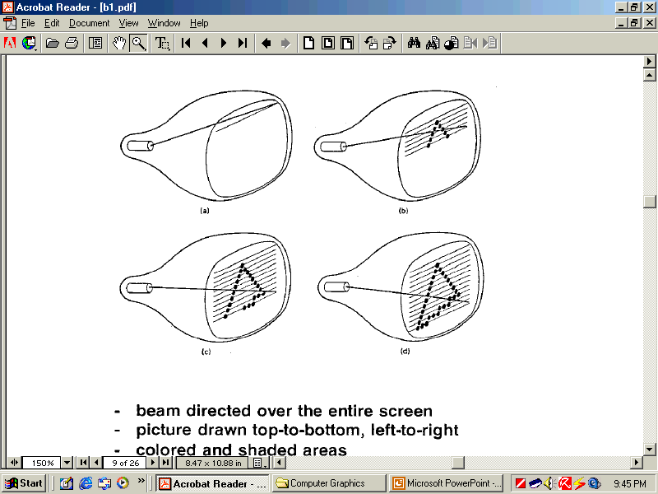
Kinds of Displays
(1) Raster scan:-
  Raster scan video monitors is about shoot the electron beam overall parts of the screen (line by line)
  The picture is created on the screen as a set of points as shown in the figure
  The capability of “Raster scan” system to store intensity information for each screen point makes it suitable for displaying complex shape
  Higher refresh rates are usually needed. To solve this problem; we use the technique “interlacing”

Slide 78
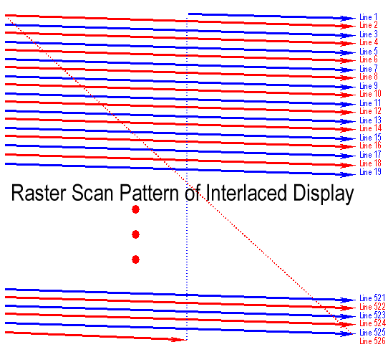
(1) Raster scan-contn
Interlacing re-visit
  the refresh cycle on raster scan monitors is carried out by sweeping the beam over the even frame from top to the bottom and repeating it for the odd frame (i.e. the raster cycle is broken into 2 sweep pattern.
  Each of it consisting of half the number of raster lines in the original scan pattern).

Slide 79
Random (Raster) Display-contn
Beam directed over the entire screen, Picture drawn top to bottom, left to right
Colored and shaded areas, Refresh 30-60 times per second (sometimes interlaced)
A raster display consists of a matrix of dots, called pixels (picture matrix elements).
A pixel is the smallest addressable unit on the display surface.
Workstation screen normally consists of 1280 x 1024 = 1.2M such pixels.
Raster devices include the monitor of a computer, the laser-jet or ink-jet printer.
The color values of all pixels are stored in the frame buffer (refresh buffer).
Each row of pixels is called a scan-line or a raster line.

Slide 80
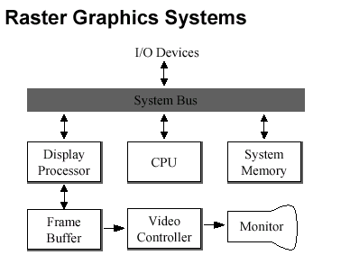
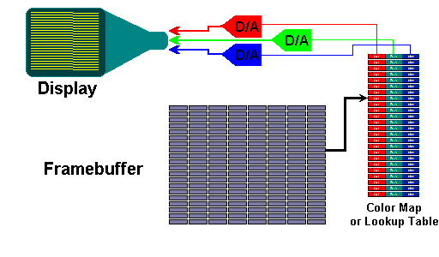
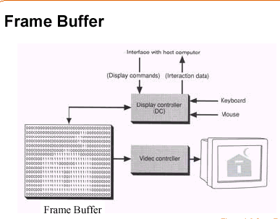
Raster Display-contn

Slide 81
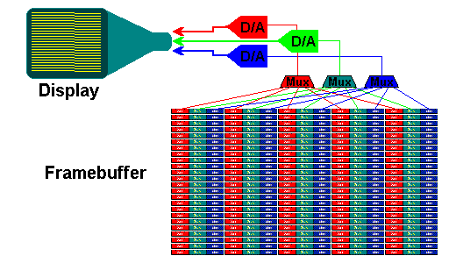
True-Color FrameBuffers
Each pixel requires at least 3 bytes. One byte for each primary color.
Sometimes combined with a look-up table per primary
Each pixel can be one of 2 ^{3x8} = 2 ²⁴ colors

Slide 82
(2) Vector Mode (random mode)
The electron beam is direct on the screen only to the parts of the picture is to be drawn. i.e. it draws one line per a time, so they are referred to as “vector displays”.
Advantages :
The vector scan is a faster line drawing display.
It requires less computer memory, because only the end points of the lines are stored.
Disadvantages : Vector system is restricted to line drawing application only.

Slide 83
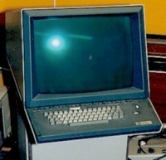
Vector Displays-contn
Oscilloscopes were some of the 1st computer displays
used by both analog and digital computers
Called vector, calligraphic or
affectionately stoker displays
Display list had to be constantly updated
(except for storage tubes)
The two primary problems with vector displays are:
they required constant updates to avoid fading, thus limiting the drawn scene's complexity, and
they only drew wire –frames which is used for visualization of the underlying design structure of a 3D model

Slide 84
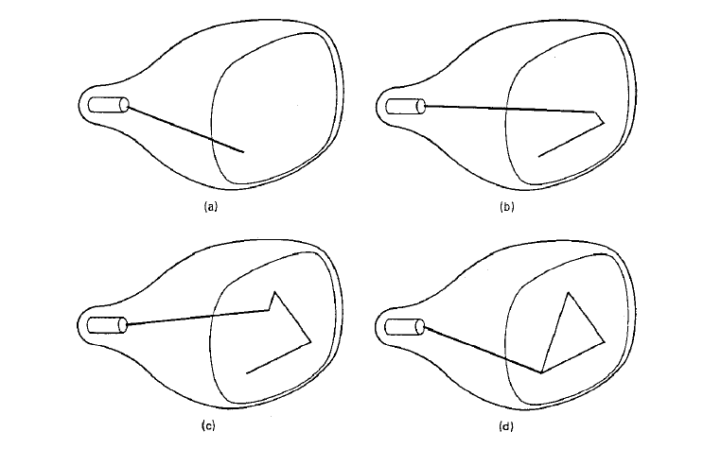
Vector Displays-contn
Random Scan (vector, stroke, calligraphic ) displays
Beam directed only to parts of the screen where a picture is to be drawn
Picture drawn in any order
Line drawing only &Refresh 30-60 times/second

Slide 85
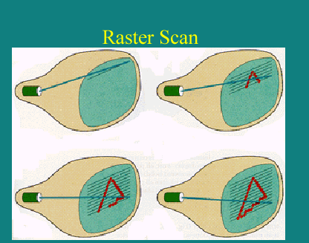
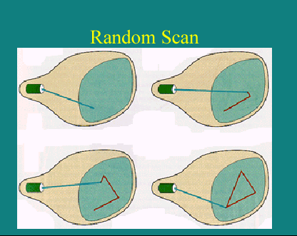
Random and Raster Scan comparison

Slide 86
Definitions
Image: is represented by a 2D array of pixels with color coding
Pixel (Picture Cell) : is the smallest addressable unit on the display surface
Refresh rate: is the amount of raster lines the beam sweeps per second
Phosphor persistence: is defined as the time it takes emitted light to decay to one-tenth of the original intensity (low persistence requires higher refresh rates).

Slide 87
Definitions-Contn
Blurred image: occurs if the refresh rate is greater than the phosphor persistence.
Flicker: It’s the flash on and off when the persistence of phosphor used is not matched the refresh rate.
Workstation: it allows the user to work with an interactive graphic applications. The workstation may be just a PC or a graphical terminal connected to the host system.
A workstation should have its:
local processor,
mass storage,
high resolution graphic display
a number of graphics input device.

Slide 88
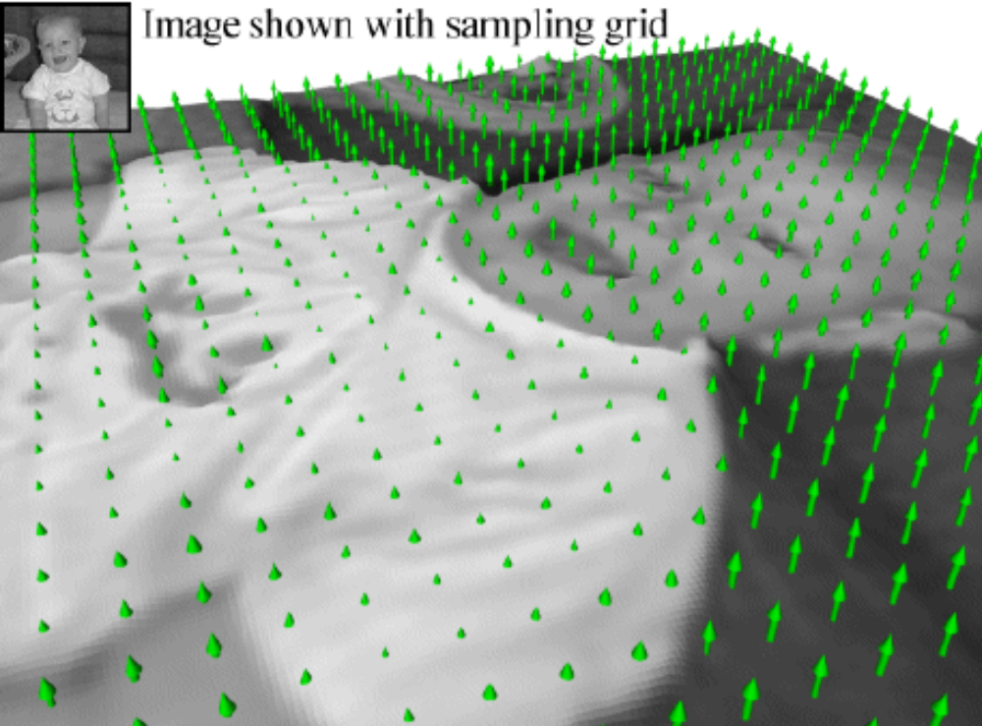

Pixels
The result of sampling an image is pixels
Applying the same sampling grid to geometric object is called rasterization

Slide 89
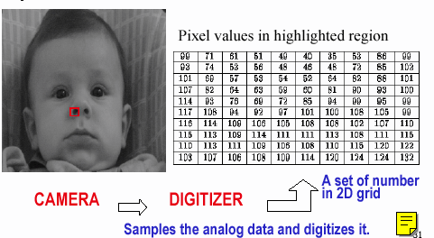
Digital Image Representation

Slide 90
1.3.2 Liquid Crystal Displays (LCDs)
It produces picture by passing polarized light through a liquid crystal material ( filter ) that can be aligned either to block or transmit the light
Constructed from two glass plates each containing:
a light polarizer at right angle to each other,
sandwich the Liquid Crystal material and
rows and columns of conductor at each plate, the intersection of them define the pixel position
We apply a voltage at the pixel position to determine “on-off” states of light

Slide 91
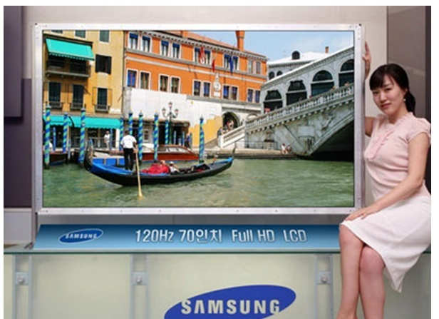
LCD monitor sample

Slide 92
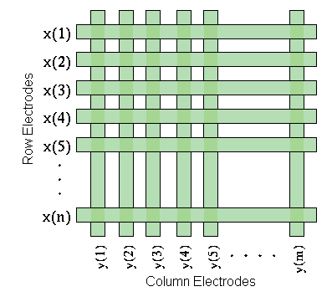
Reflective and Backlit LCDs
Rather than generating light like a CRTs, LCDs act as light values. Therefore, they are dependent on some external light source. In the case of a transmissive display, usually some sort of back light is used

Slide 93
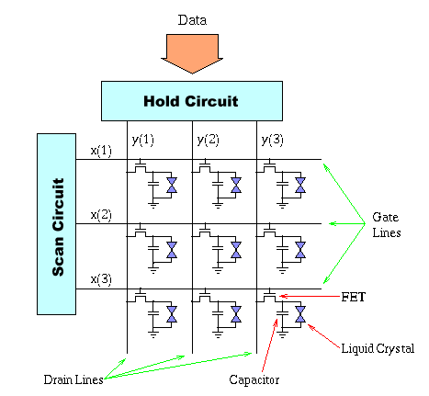
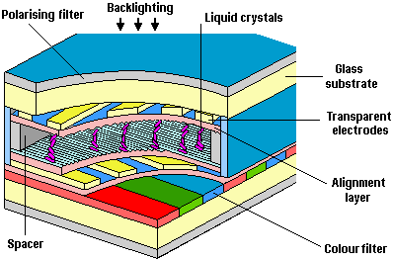
Active Matrix LCDs
The LCD's themselves have extremely low power requirements.
A very small electric field is required to excite the crystals into their liquid state.
Most of the energy used by an LCD display system is due to the back lighting.

Slide 94
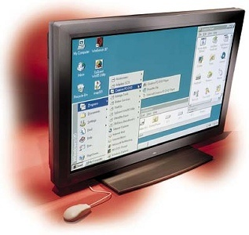
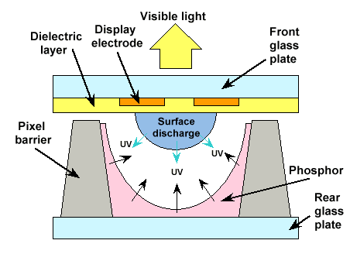
1.3.3 Plasma Display Panels
Promising for large format displays
Basically fluorescent tubes
High-voltage discharge excites gas mixture
Upon relaxation UV light is emitted
UV light excites phosphors
Large viewing angle

Slide 95
Plasma Display Panels-contn
  Disadvantages:
  Not as bright
  More power
  Advantages:
  Large pixels (~1mm compared to 0.2mm for CRT)
  No refresh required

Slide 96
1.4 Up _ to _date Technologies
Field Emission Display (FED’s)
Digital Micro_mirror Devices ( DMD )
Light Emitting Diode ( LED )
Liquid Crystal on Silicon ( LCOS )
Gratings Light Valves ( GLV )

Slide 97
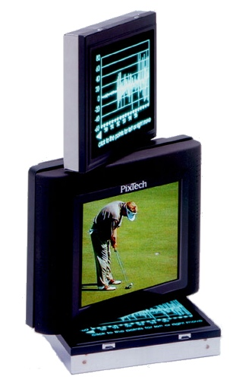
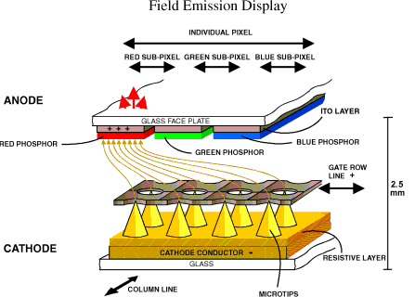
Field Emission Devices (FEDs)

Slide 98
Field Emission Devices (FEDs)
Works like a CRT with multiple electron guns at each pixel
Uses modest voltages applied to sharp points
to produce strong E fields
Reliable electrodes proven difficult to produce
Limited in size, thin, and requires a vacuum

Slide 99
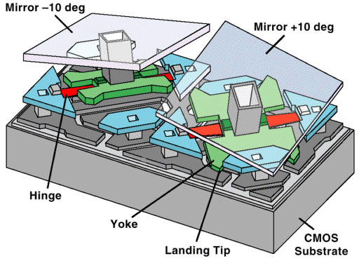
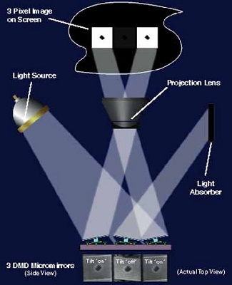
Digital Micro_mirror Devices (DMDs)

Slide 100
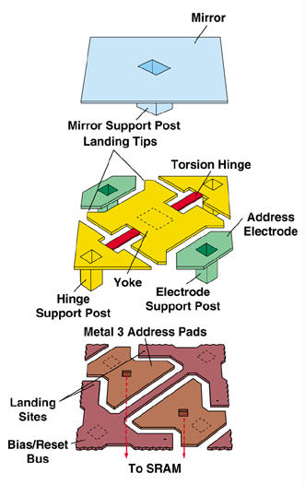
Digital Micro_mirror Devices (DMDs)
The DMD is a chip that has anywhere from 800 to more than 1 million tiny mirrors on it, depending on the size of the array.
Each 16-µm2 mirror on a DMD consists of three physical layers and two "airgap" layers.
The airgap layers separate the three physical layers and allow the mirror to tilt +10 or -10 degrees.

Slide 101
Digital Micro_mirror Devices (DMDs)
Micro-electro-mechanical (MEMs) devices
Fabricated using VLSI processing techniques
2-D array of mirrors having tilts +/- 10 degrees electr-ostatically controlled
Truly digital pixels
Suitable only for projection displays
Gray levels via Pulse-Width Modulation (PWM)
Color via multiple chips or a color-wheel
Excellent resolution
Light efficient, but problems with stray light and flicker

Slide 102
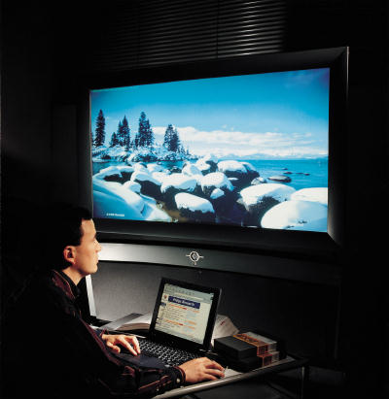
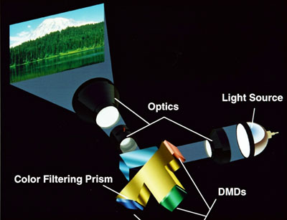
Digital Micro_mirror Devices (DMDs)

Slide 103

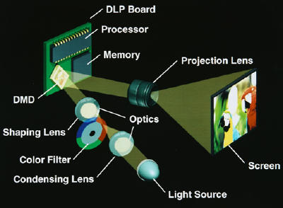
Digital Micro_mirror Devices (DMDs)

Slide 104
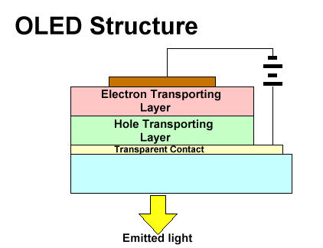
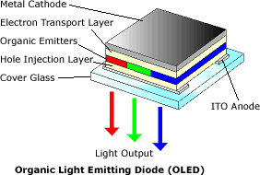
Light Emitting Diode (LED) Arrays
Organic Light Emitting Diodes (OLEDs)
Function is similar to a semiconductor LED
Thin-film polymer construction
Potentially simpler processing

Slide 105
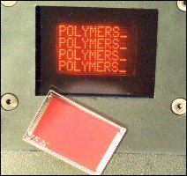
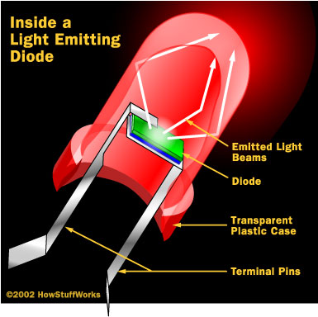
Light Emitting Diode (LED) Arrays
Transparent
Flexible
Can be vertically stacked
Excellent brightness
Large viewing angle
Efficient (low power/low voltage)
Fast (< 1 micro sec)
Can be made large or small
Tend to breakdown

Slide 106
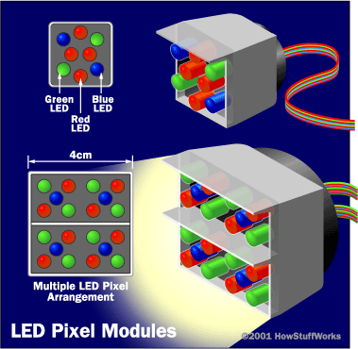
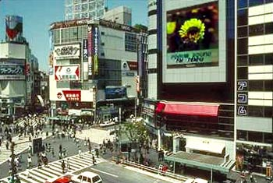

Light Emitting Diode (LED) Arrays

Slide 107

LCOS Technology
(Liquid crystal on silicon)
Crystals are coated over the surface of a silicon chip. The electronic circuits that drive the formation of the image are fixed into the chip, which is coated with a reflective (aluminized) surface
The LCOS devices are easier to manufacture than conventional LCD displays
They have higher resolution because several million pixels can be etched onto one chip

Slide 108


Gratings Light Valves Technology(GLV)
The GLV chip consists of tiny reflective ribbons mounted over a silicon chip.
The ribbons are suspended over the chip with a small air gap in between.
When a voltage is applied to the chip below a ribbon, the ribbon moves toward the chip by a fraction of the wavelength of the illuminating light.

Slide 109
GLV Technology
The deformed ribbons form a diffraction grating, and the various orders of light can be combined to form the pixel of an image.
The shape of the ribbons, and therefore the image information, can be changed in as little as 20 billionths of a second
A major advantage of GLV technology is that GLV chips can make:
high-resolution images at a relatively low cost

